Slide 1


Scrum
Damian Gordon / Paul Kelly

Slide 2
Overview
Scrum is an enabler for building software products better and faster.
Scrum is designed to help teams create/maintain complex software products in turbulent and unpredictable circumstances.
The term ‘Scrum’ refers to the game of rugby.
Scrum wants to stress the importance of teams, using analogies between a team sport like rugby and being successful in the game of product development.

Slide 3

Scrum is made up of Sprints
Scrum focuses on developing the product in a series of fixed-length iterations called sprints (usually 1-2 weeks).
Sprints allow the Development Team to focus on achieving a SMART Sprint Goal.
The goal of each Sprint is to deliver a valuable piece of working software
All of the work in Scrum is organized in Sprints

Slide 4
Ceremonies
Scrum calls for four ceremonies that bring structure to each sprint:
Sprint planning: A team planning meeting that determines what to complete in the coming sprint.
Daily stand-up: Also known as a Daily Scrum, a 15-minute mini-meeting for the software team to sync.
Sprint demo: A sharing meeting where the team shows what they've shipped in that sprint.
Sprint retrospective: A review of what did and didn't go well with actions to make the next sprint better.

Slide 5
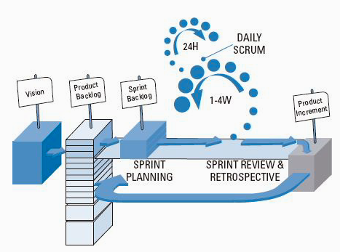
Scrum

Slide 6
Scrum
During a sprint, visual artefacts like task boards and burndown charts, visible to the team and spectators alike, are powerful motivators.

Slide 7
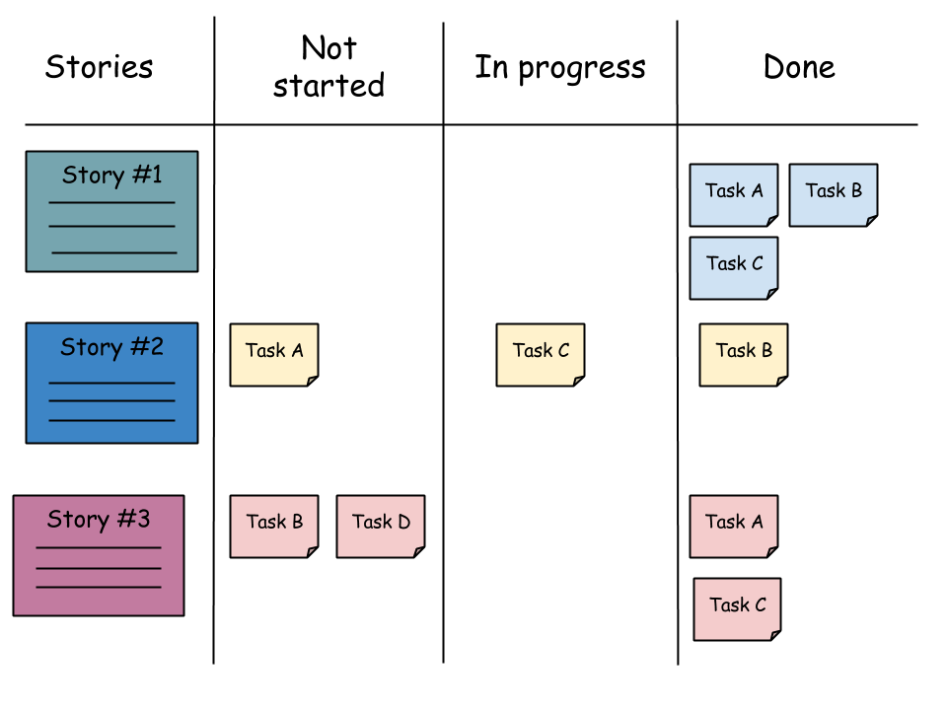
Scrum
Task boards:

Slide 8
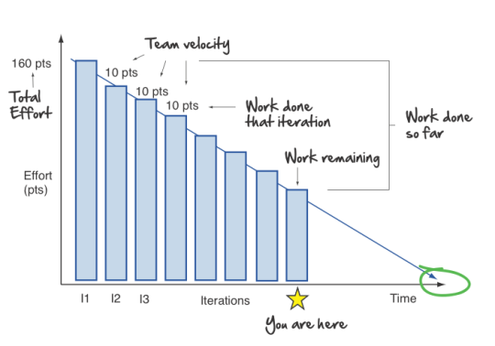
Scrum
Burndown charts:

Slide 9
Scrum
A scrum team has a slightly different composition than a traditional waterfall project, with three specific roles:
product owner,
scrum master, and
the development team.
Because scrum teams are cross-functional, "the development team" includes testers, designers, and ops engineers in addition to developers.

Slide 10
Product Owner
creates a prioritized wish list called a product backlog
closely partners with the business and the team to ensure everyone understands the work items in the product backlog
gives the team clear guidance on which features to deliver next
decides when to ship the product with a preference towards more frequent delivery

Slide 11
Scrum Master
The Scrum Master is the champion for scrum within their team.
They coach the team, the product owner, and the business on the scrum process and look for ways to fine-tune their practice of it.
An effective scrum master deeply understands the work being done by the team and can help the team optimize their delivery flow.
They schedule the needed resources (both human and logistical) for sprint planning, stand-up, sprint review, and the sprint retrospective.

Slide 12
Development Teams
Agile development teams use pull models where the team pulls a certain amount of work off the backlog and commits to completing it that sprint.
This is very effective in maintaining quality and ensuring optimum performance of the team over the long-term.

Slide 13
Scrum
The most effective Scrum Teams are tight-knit, co-located, and usually 5 to 7 members. Team members have differing skill sets, and cross-train each other so no one person becomes a bottleneck in the delivery of work.
The Scrum Team drives the plan for each sprint. They forecast how much work they believe they can complete over the iteration using their historical velocity as a guide.

Slide 14
Questions?
Questions?

